Slide 1
Electronic Devices
Mid Term Lecture - 06
Reference book:
Electronic Devices and Circuit Theory
Robert L. Boylestad and L. Nashelsky , (11th Edition)

Slide 2
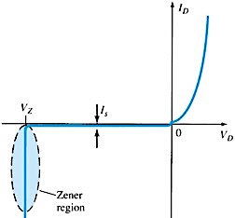
ZENER REGION
If the Diode is reverse biased and the voltage is increased, a point will be reached when the diode enters reverse breakdown and current will flow with a very rapid rate.
The direction of this current will be opposite to that of the positive voltage region.
The reverse bias potential that results in this dramatic change in characteristics is called the Zener Potential /Voltage and is given by the symbol V_{z}.
The reverse or Avalanche breakdown is often termed as Zener Breakdown (at very low levels).

Slide 3
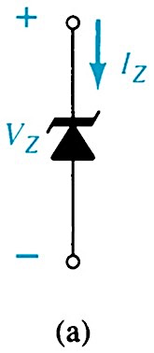
ZENER DIODE
A zener diode operates in reverse bias.
Common Zener Voltages: 1.8V to 200V.

Slide 4
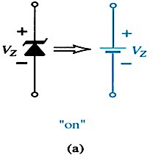
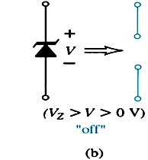
ZENER DIODE
The off state is defined by a voltage less than V_{z} but greater than 0V. The Zener equivalent is the open circuit.

Slide 5
ZENER DIODE
The Zener diode is a heavily doped diode which, as a result of doping, has a very narrow depletion region. This allows the diode to be operated in the reverse biased region of the characteristic curve without damaging the PN junction.
Because of its higher temperature and current capability, silicon is usually preferred in manufacture of Zener Diodes.
Zener Diodes provide a stable reference voltage for use in power supplies, voltmeter & other instruments, voltage regulators.

Slide 6
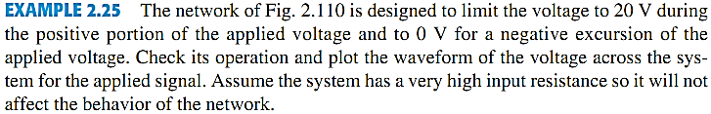
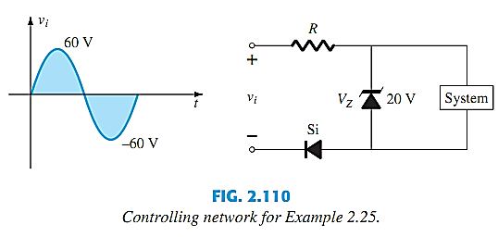
ZENER DIODE EXAMPLE

Slide 7
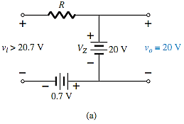
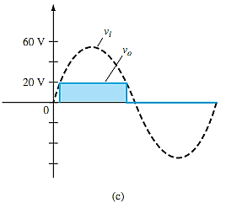
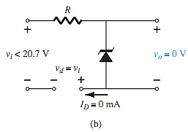
ZENER DIODE EXAMPLE

Slide 8
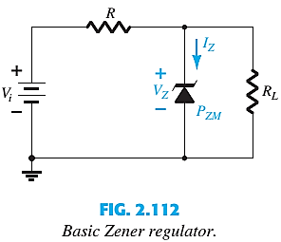

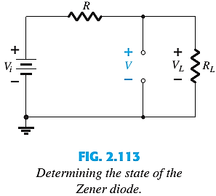
1st CONDITION: V_{i} AND R FIXED
The simplest of Zener diode regulator networks appears in Fig. 2.112 . The applied dc voltage is fixed, as is the load resistor. The analysis can fundamentally be broken down into two steps.
1. Determine the state of the Zener diode by removing it from the network and calculating the voltage across the resulting open circuit.
If V ≥ V_{Z}, the Zener diode is on, and the appropriate equivalent model can be substituted.
If V < V_{Z}, the diode is off, and the open-circuit equivalence is substituted.

Slide 9



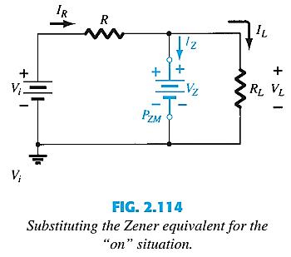

1st CONDITION: V_{i} AND R FIXED
2. Substitute the appropriate equivalent circuit and solve for the desired unknowns.
For the network of Fig. 2.112 , the “on” state will result in the equivalent network of Fig.2.114 . Since voltages across parallel elements must be the same, we find that
The power dissipated by the Zener diode is determined by
That must be less than the P_{ZM} specified for the device.

Slide 10

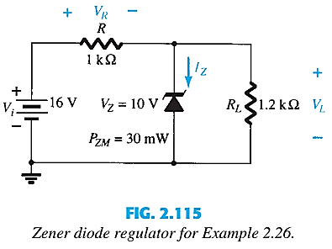
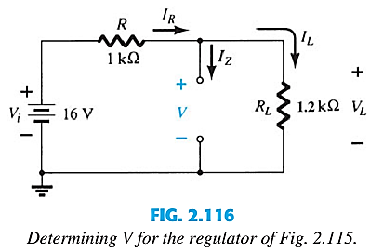

1st CONDITION: V_{i} AND R FIXED

Slide 11
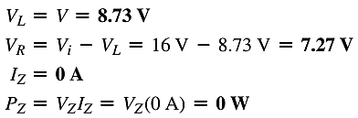
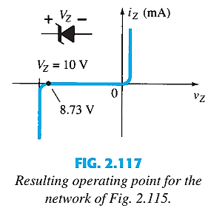

1st CONDITION: V_{i} AND R FIXED

Slide 12
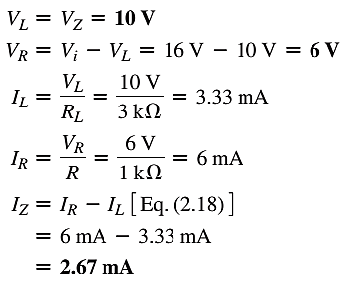
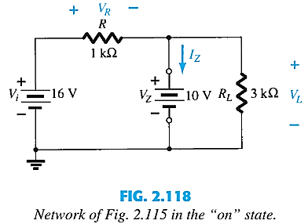

1st CONDITION: V_{i} AND R FIXED

Slide 13



2nd CONDITION: FIXED V_{i}, VARIABLE R_{L}
Due to the offset voltage V_{z}, there is a specific range of resistor values (and therefore load current) which will ensure that the Zener diode is in the on state.
Too small R_{L} → V_{L} < V_{z} → Zener diode will be in the off state.
To determine the min R_{L} that will turn the Zener diode on :
Any load resistance value greater than the R_{L} min will ensure that the Zener diode is in the on state and the diode can be replaced by its V_{z} source equivalent.
The max I_{L}

Slide 14





2nd CONDITION: FIXED V_{i}, VARIABLE R_{L}
Once the diode is in the on state, the voltage across R remains fixed at:
I_{z} is limited to I_{ZM} as provided on the data sheet, it does affect the range of R_{L} and therefore I_{L}.
The maximum load resistance
See Example 2.27.

Slide 15





3rd CONDITION: FIXED R_{L}, VARIABLE V_{i}
For fixed values of R_{L}, the voltage V_{i} must be sufficiently large to turn the Zener diode on. The min turn-on voltage V_{i}=V_{i min} :
The max value of V_{i} is limited by the max Zener current I_{ZM}.
Since I_{L} is fixed at V_{Z}/R_{L} and I_{ZM} is the max value of I_{Z}, the max V_{i} is defined by:

Slide 16
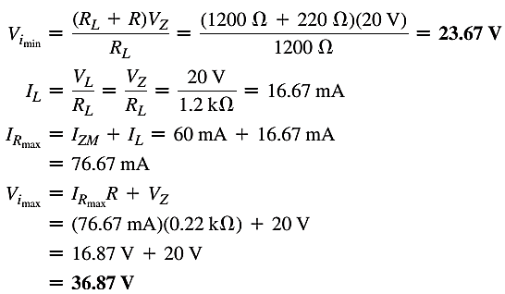
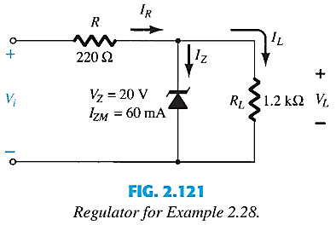
3rd CONDITION: FIXED R_{L}, VARIABLE V_{i}

Slide 17
Thank You

